Slide 1
Ethical Student Hackers
Intro to Assembly

Slide 2
The Legal Bit
The skills taught in these sessions allow identification and exploitation of security vulnerabilities in systems. We strive to give you a place to practice legally, and can point you to other places to practice. These skills should not be used on systems where you do not have explicit permission from the owner of the system. It is VERY easy to end up in breach of relevant laws, and we can accept no responsibility for anything you do with the skills learnt here.
If we have reason to believe that you are utilising these skills against systems where you are not authorised you will be banned from our events, and if necessary the relevant authorities will be alerted.
Remember, if you have any doubts as to if something is legal or authorised, just don't do it until you are able to confirm you are allowed to.

Slide 3
Code of Conduct
Before proceeding past this point you must read and agree to our Code of Conduct - this is a requirement from the University for us to operate as a society.
If you have any doubts or need anything clarified, please ask a member of the committee.
Breaching the Code of Conduct = immediate ejection and further consequences.
Code of Conduct can be found at https://shefesh.com/downloads/SESH%20Code%20of%20Conduct.pdf

Slide 4
What is assembly?
Assembly is a human readable version of machine-code that is as close as you can get to the “bare metal”
Every processor architecture has its own assembly language – some common ones:
x86 (The one we are learning today)
ARM (In mobile devices and the new Macbooks)
RISC-V (A neat, newish open-source architecture)
Though different architectures have different instructions and registers, many of the concepts are the same
If you’d like to see a very basic (and quite fictional) assembly language, check out TIS-100!

Slide 5
Why is it useful to know assembly?
Low level development
At the level of operating systems and bootloaders, this is sometimes the only language available!
These layers of the stack can often hide hard-to-find security vulnerabilities!
Near-direct translation of machine-code
Binary programs can be disassembled and reverse-engineered
An understanding at this level helps understand concepts in other languages
Systems-programming languages like C/C++ and Rust have some overlap
Higher level languages like Python are much farther from this level though

Slide 6
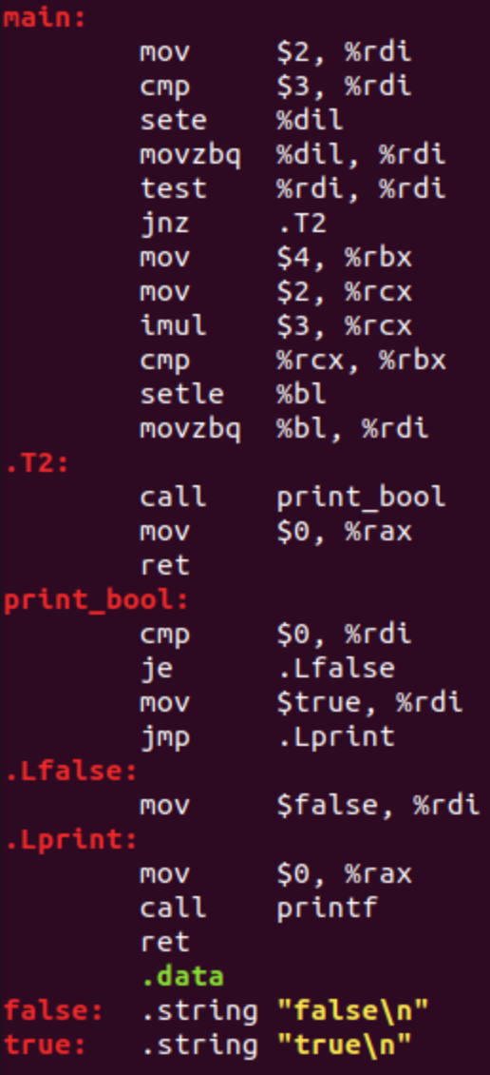
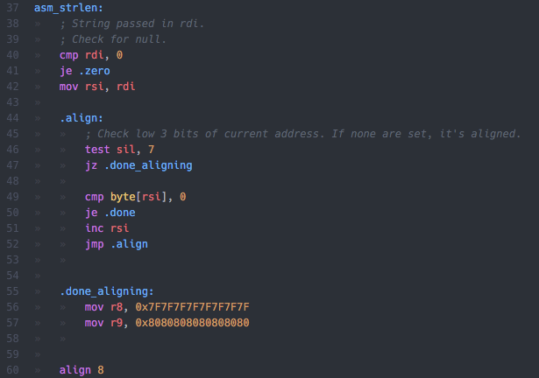
Some basic syntax

Slide 7
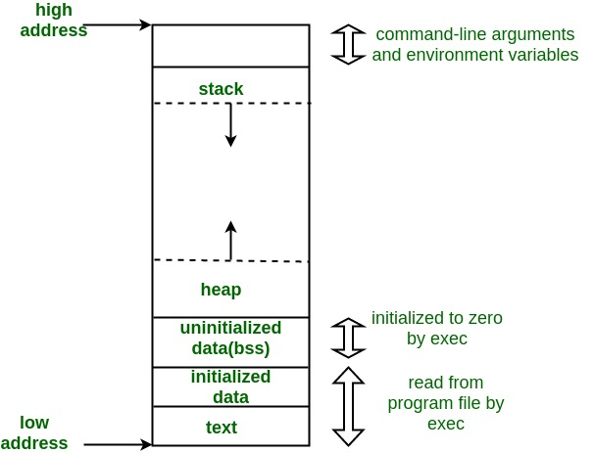
Layout of assembly
Data section
Contains data that is constant once initialised
Cannot be changed during execution
BSS section
Used for declaring variables during execution
Dynamic, can be changed
Text section
The assembly to execute

Slide 8
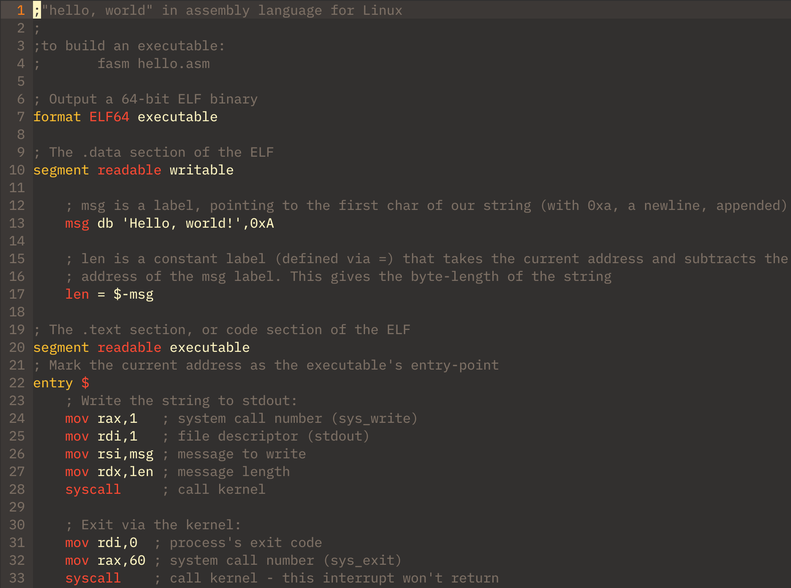
Layout in FASM

Slide 9
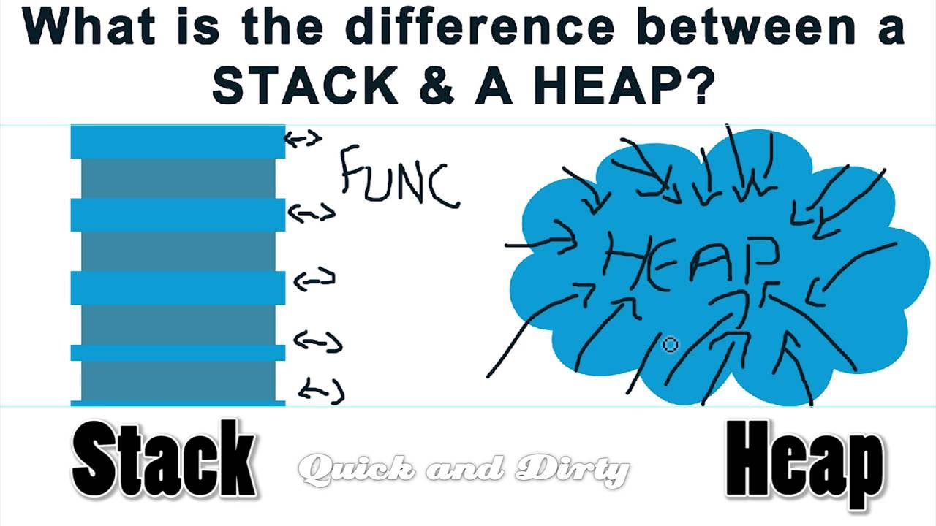
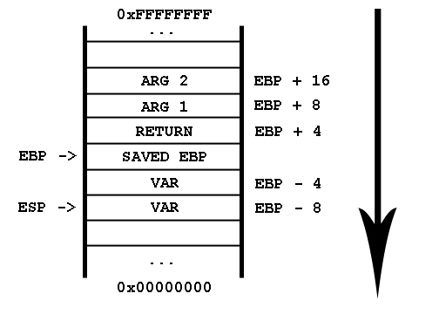
The Stack (Maybe Some Heap Too)
What is the stack, and heap?
The stack grows down in memory
The heap grows up in memory
Stack frames
Growing the stack
Restoring the stack

Slide 10
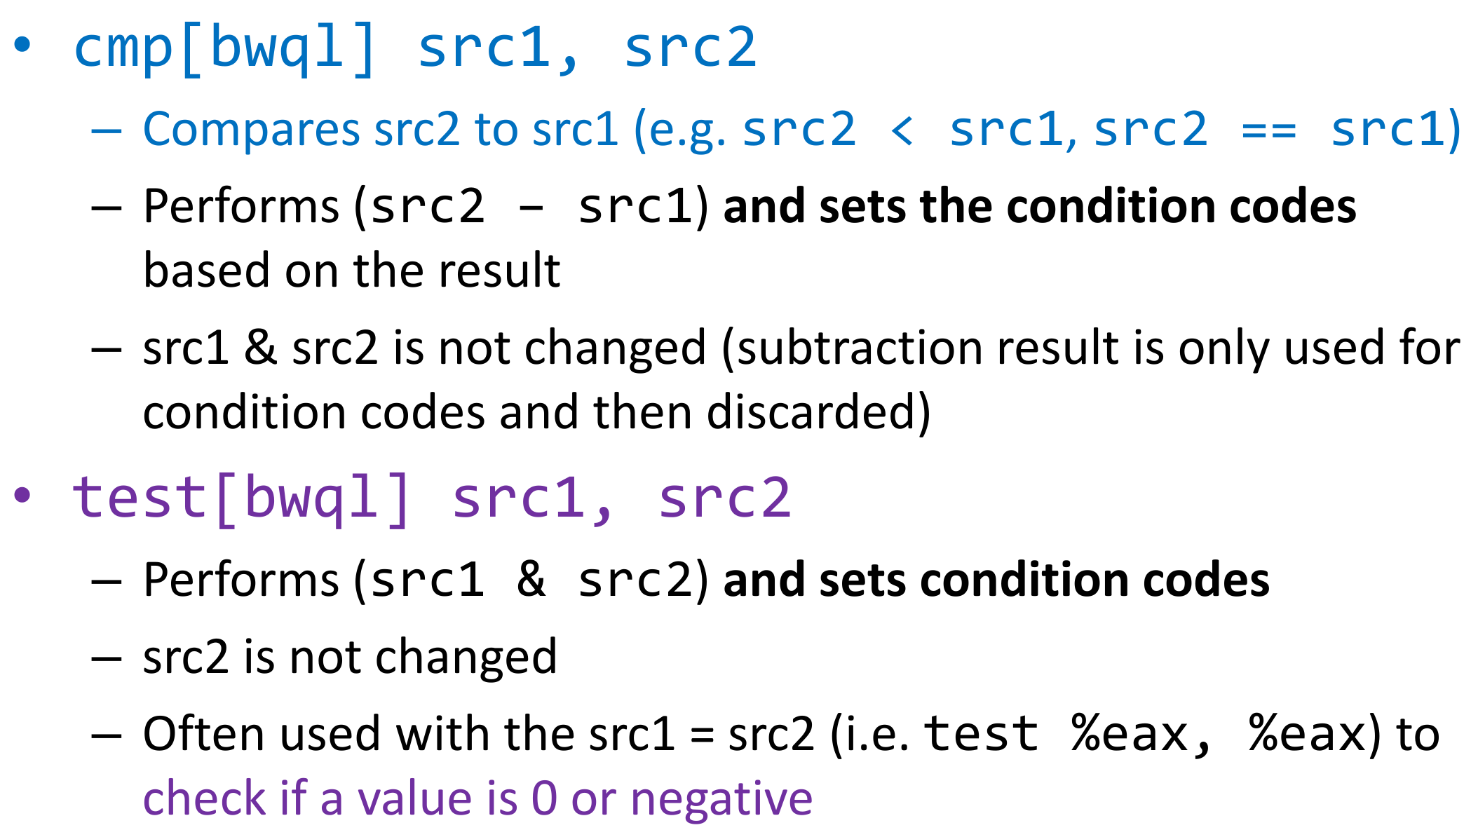
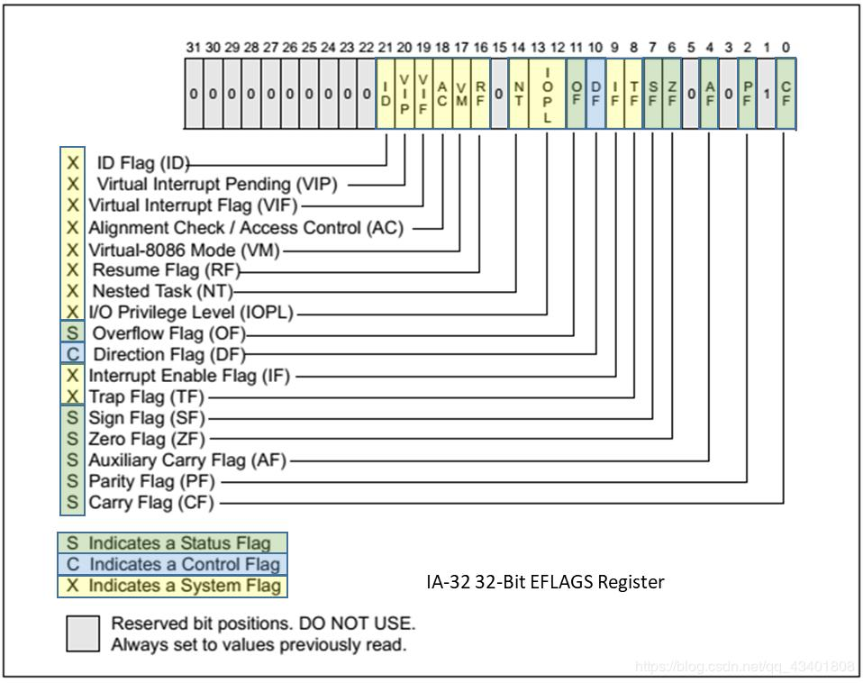
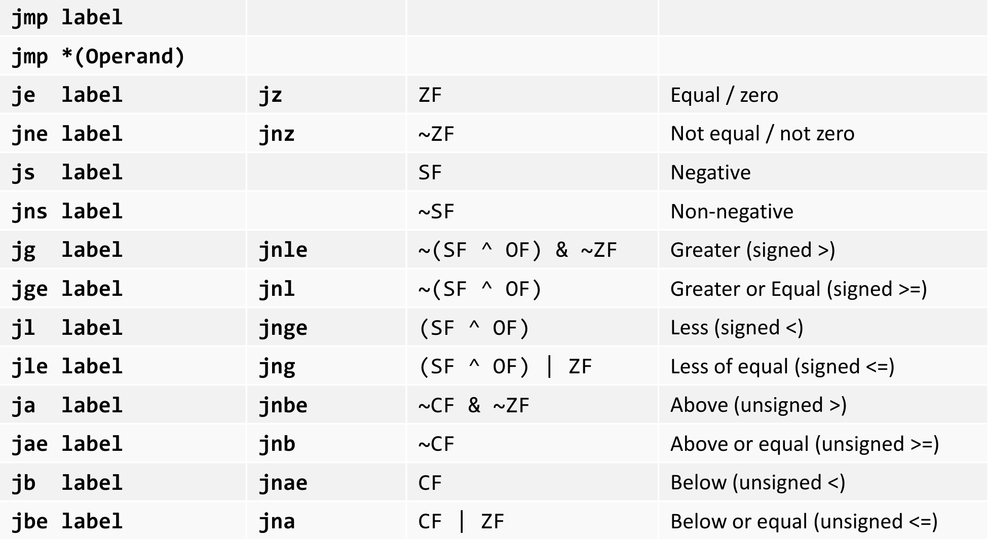
Control Flow

Slide 11
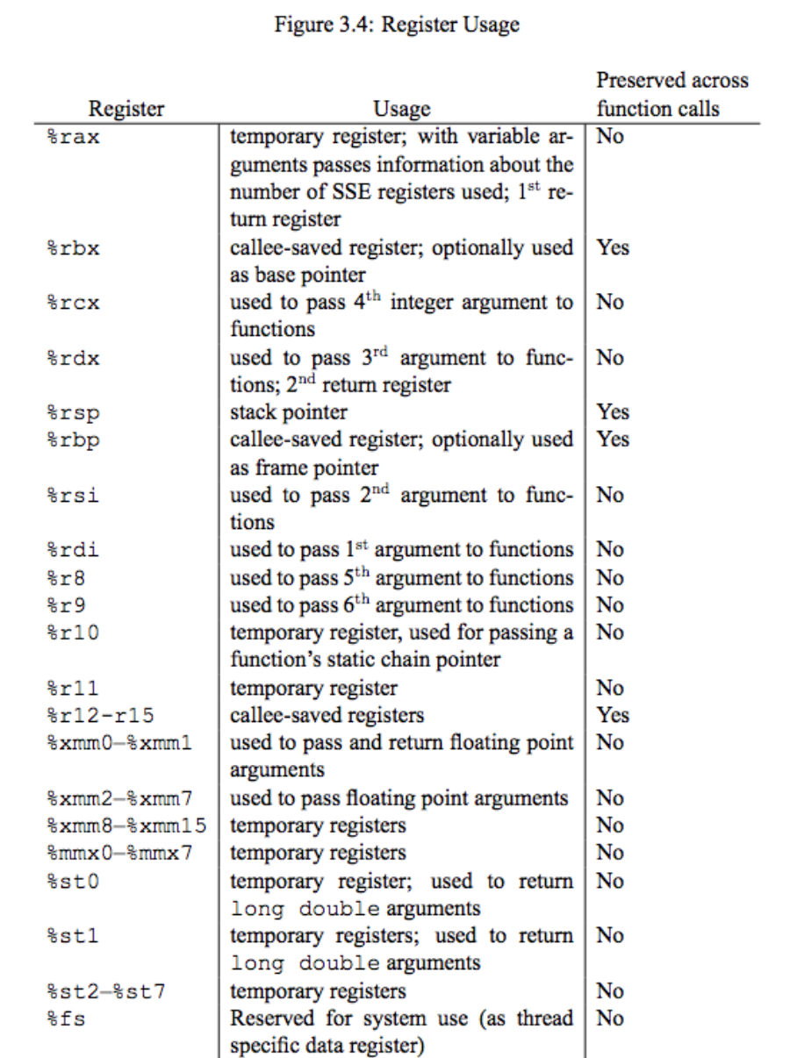
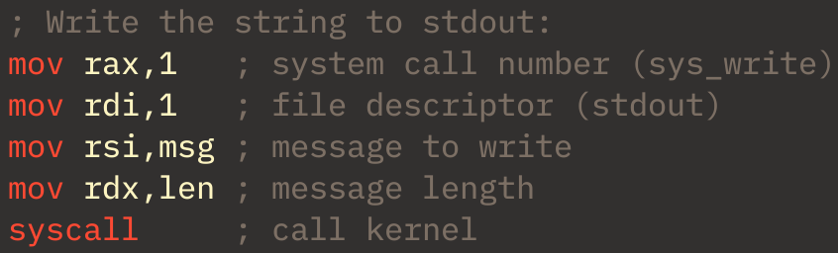
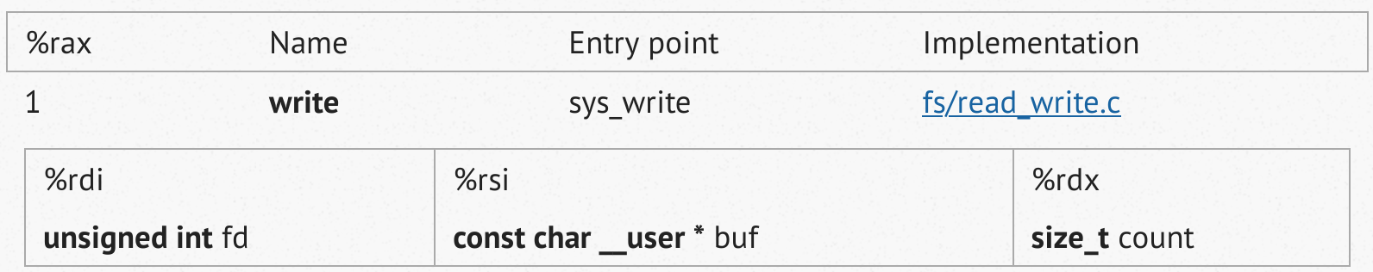
System Calls
https://filippo.io/linux-syscall-table/

Slide 12
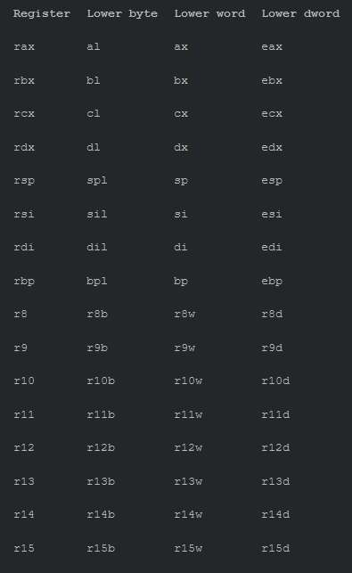
Registers
Registers are a very small location in the CPU that can store and access values very quickly.
Very similar to RAM, but a lot faster to access
They are used to store values while the processor is executing instructions
Each general-purpose register is 64 bits wide
Each 1, 2, 4 and 8 bytes can be accessed individually
There are other more specialised registers such as the RFLAGS register
Notes:
A ‘word’ is 2 bytes, a double-word (DWORD) is 4 bytes and a QWORD is 8 bytes
RFLAGS register is a register that specifies to the CPU what the current process is allowed to access, for example if the bit 12-13 is set then the process is allowed I/O privilege level and access
https://youtu.be/T_Uf2wkaMKY?list=PLMOpZvQB55bcRA5-KjvW7dVyGUarcqZuL - A cool video by Andreas Kling on exploiting the EFLAGS register in the linux based SirenityOS.

Slide 13
General-Purpose Registers
64-bit | 32-bit | 16-bit | 8 high bits of lower 16 bits | 8-bit | Description
RAX | EAX | AX | AH | AL | Accumulator
RBX | EBX | BX | BH | BL | Base index (for use with arrays)
RCX | ECX | CX | CH | CL | Counter for loops and strings
RDX | EDX | DX | DH | DL | Data (commonly extends the A register)
RSI | ESI | SI | N/A | SIL | Source index for string operations
RDI | EDI | DI | N/A | DIL | Destination index for string operations
RSP | ESP | SP | N/A | SPL | Stack Pointer
RBP | EBP | BP | N/A | BPL | Base Pointer (meant for stack frames)
R8.. R15 | R8D..R15D | R8W..R15W | N/A | R8B..R15B | General purpose registers 8 to 15
x86 & x86-64
x86-64 only

Slide 14
Special Registers
64-bit | 32-bit | 16-bit | Description
RIP | EIP | IP | Instruction Pointer
Instruction pointer register
Contains the location of the next instruction
R/E/FLAGS register contains the current state of the CPU
Contains useful flags such as Zero, Overflow, Parity, Carry and I/O Privilege level flags
https://en.wikipedia.org/wiki/FLAGS_register
Control registers CR0 to CR7
CR0 contains controls for paging, write protections and other things relating to memory
CR3 is used for virtual addressing
CR4 is used when in protected mode (stops apps writing over each other)
x86 & x86-64
x86-64 only
Notes:
For RFLAGs, first 21 bits are assigned for purpose, the last 22-63 are reserved
Protected mode stops some apps from writing over each other
Is enabled in CR0 but has it’s own register CR4 for when it’s enabled

Slide 15
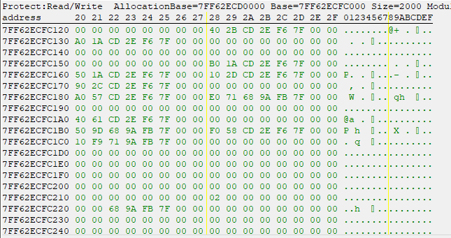
Memory and Addresses
Memory (or RAM) is a collection of numbered ‘cells’ that are 8 bits in size (1 byte)
For example, in the image below you can see the cell 7FF62ECFC128 stores hex 40
We can access multiple bytes at a time:
mov rdi, myNum ; pointer to long
mov rax, QWORD [rdi+8] ; read *next* long from memory
ret
myNum:
dq 117 ; puts one QWORD in memory [myNum+0]
dq 42 ; puts another QWORD in memory [myNum+8]
Windows (and Linux?) have address spaces that are assigned to applications
This stops applications overwriting or viewing each others data
Notes:
Windows and Linux? Have a virtual address space that the applications run in. This means that one process cannot overwrite the memory of another process space.
The virtual mapping is then mapped to the physical address in memory.
Red values are where the data is stored in the register, blue is what is to be moved into the register

Slide 16
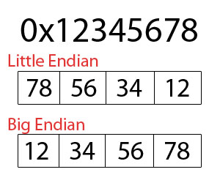
Endianness & Bitwise Operations
Little Endian and Big Endian are simply two ways of representing data
Operand 1: 0101 1010 Operand 2: 0011 1001
AND Op1, Op2 # Op 1 = 0001 0000
OR Op1, Op2 # Op 1 = 0111 1011
XOR Op1, Op2 # Op 1 = 0110 0011
NOT Op1 # Op 1 = 1010 0101
SAR Op1, 3 # Op 1 = 0000 1011 Logical shift Right by 3
SAL Op1, 3 # Op 1 = 1101 0000 Logical shift Left by 3
Notes:
Endianness is mainly important when computers are networking with one another, as they need to have a pre-agreeded endianness.
Big endian is generally easier to read
Intel x86 and AMD64 / x86-64 use Little Endian format
Some IBM architecture and Motorola 68000 series-based chips use big endian
With the

Slide 17
Pointers
Pointers are a variable that stores the address of another variable
Really useful for referencing large areas of data
We can have a ‘base’ address, and then reference the data with an offset
Last slide shows this, look at ‘myNum’
In assembly, we can reference pointers like so:
mov rbx, [rsp] # Take the value from the address stored in rsp and store it in rbx
rsp = 0000021163C3C690
0000021163C3C690 = FFFFFFFFFFFFFFFF
So rbx would contain FFFFFFFFFFFFFFFF
mov [rsp], rbx # Take value in rbx and store in the memory address stored in rsp
rbx = FFFFFFFFFFFFFFFF
rsp = 0000021163C3C690
So memory address 21163C3C690 would contain FFFFFFFFFFFFFFFF

Slide 18
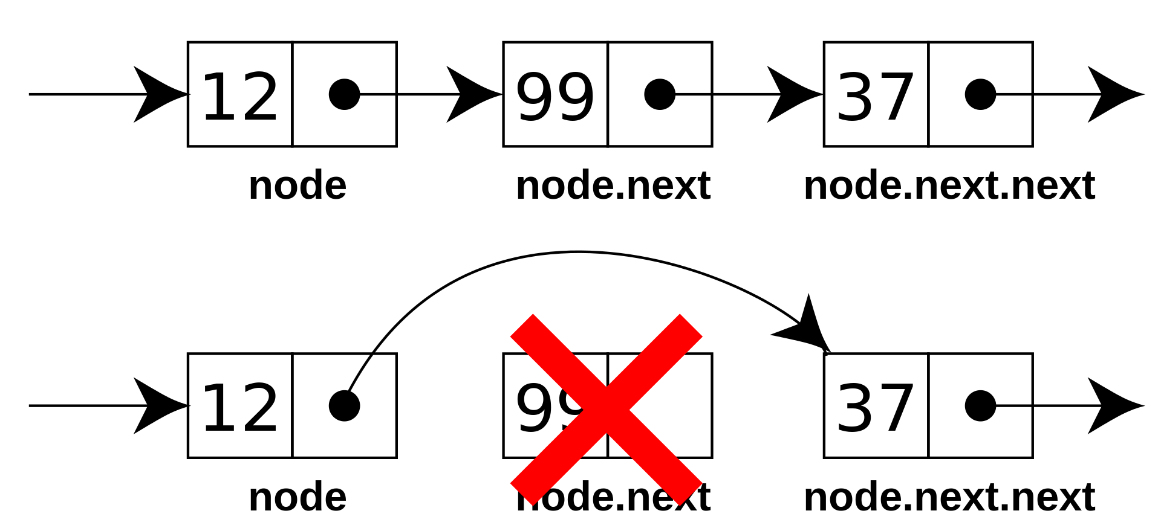
More Pointers

Slide 19
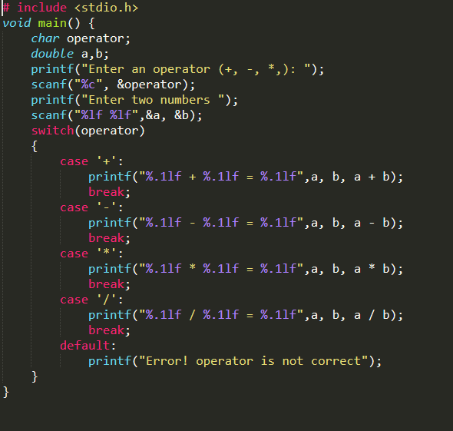

Demos Time!

Slide 20
Miscellaneous Resources
https://www.youtube.com/watch?v=DNPjBvZxE3E
https://sensepost.com/blogstatic/2014/01/SensePost_crash_course_in_x86_assembly-.pdf
http://www.cs.unc.edu/~porter/courses/cse306/s13/slides/x86-assembly-handout.pdf
https://blog.adafruit.com/2019/04/10/a-crash-course-in-x86-assembly-for-reverse-engineers-assembly-reverseengineering/
http://staff.ustc.edu.cn/~bjhua/courses/security/2014/readings/x86.pdf
https://jakash3.wordpress.com/2010/04/24/x86-assembly-a-crash-course-tutorial-i/
https://www.cs.tufts.edu/comp/40/docs/x64_cheatsheet.pdf
https://trailofbits.github.io/ctf/vulnerabilities/references/X86_Win32_Reverse_Engineering_Cheat_Sheet.pdf
https://bitvijays.github.io/LFC-BinaryExploitation.html
https://opensource.com/article/20/4/linux-binary-analysis
https://github.com/slimm609/checksec.sh
https://cutter.re/
https://montcs.bloomu.edu/Information/LowLevel/Assembly/hello-asm.html#helloLinux
https://www.youtube.com/watch?v=NcaiHcBvDR4
https://filippo.io/linux-syscall-table/

Slide 21
Upcoming Sessions
1st March: Game Hacking
8th March: Making a CTF
15th March: Web App Hacking
What’s up next?
www.shefesh.com/sessions

Slide 22

Any Questions?
www.shefesh.com
Thanks for coming!

